Slide 1
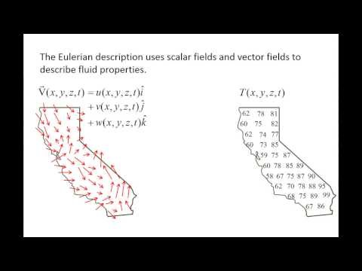
The Lagrangian and Eulerian descriptions
https://www.youtube.com/watch?v=iItS2O8Fcf8

Slide 2
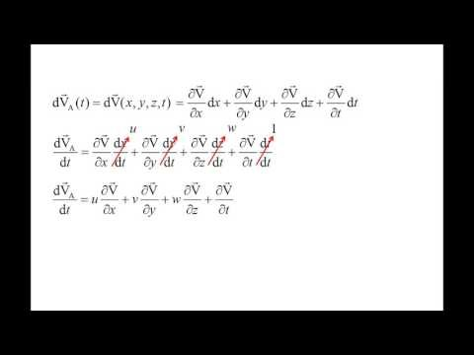
The substantial derivative
https://www.youtube.com/watch?v=p7qFS9umcx8

